Slide 1
UPPER RESPIRATORY TRACT INFECTION (URTI)
Dr.Betre W (Pediatrician ,Ass’t professor of pediatrics )

Slide 2
Outline
Define upper air way
Discussion of common upper airway infection
  Common cold
  Sinusitis
  Pharyngitis(acute tonsillopharyngitis )
  Acute ear infection
  Epiglottitis
  Laryngitis

Slide 3
Objective
At the end of this session student able to
  Define upper air way
  List common URTI with their etiology
  Describe clinical manifestation of common URTI
  List DDX of URTI

Slide 4
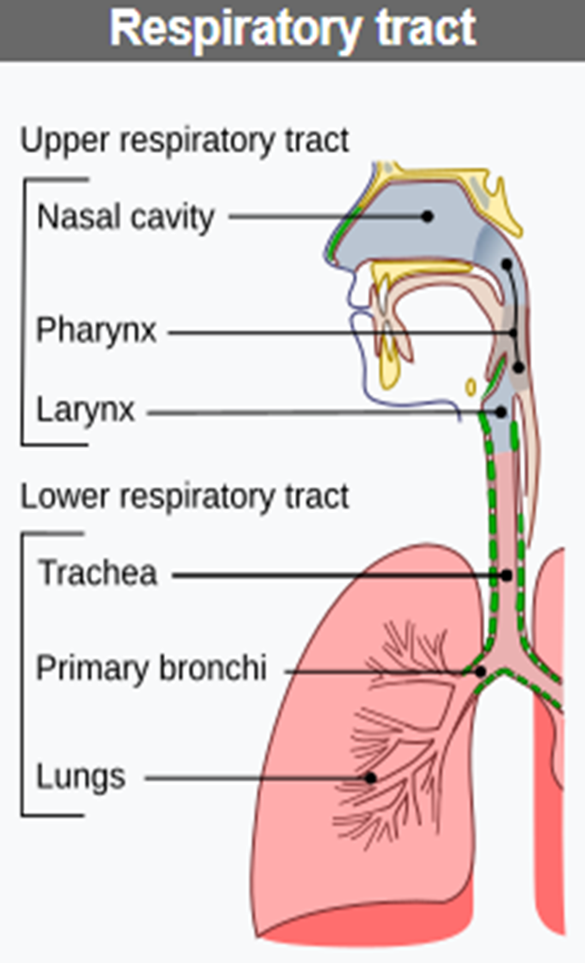
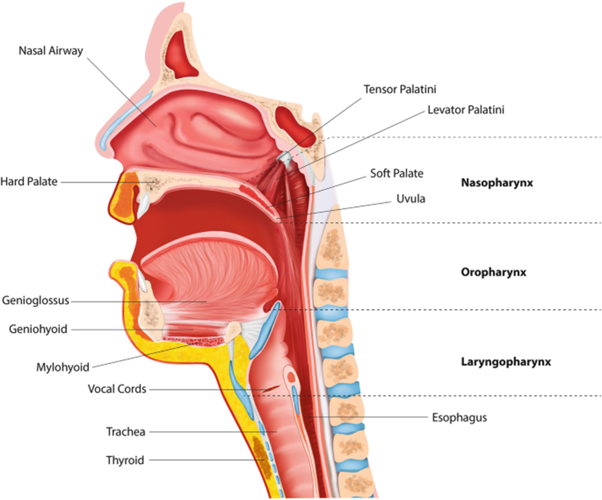
Anatomy and definition of Upper air way
Notes:
Acute respiratory infections (ARIs) are classified as upper respiratory tract infections (URIs) or lower respiratory tract infections (LRIs). The upper respiratory tract consists of the airways from the nostrils to the vocal cords in the larynx, including the paranasal sinuses and the middle ear. The lower respiratory tract covers the continuation of the airways from the trachea and bronchi to the bronchioles and the alveoli
The upper respiratory tract consists of the airways from the nostrils to the vocal cords in the larynx

Slide 5
Upper respiratory tract infection
Common URTI include
  Rhinitis (common cold),
  Sinusitis,
  Acute ear infections(AOM)
  Acute pharyngitis or tonsillopharyngitis,
  Epiglottitis, and
  Laryngitis(Croup)

Slide 6
Common cold (Rhinosinusitis)
The common cold is an acute, self-limiting viral infection of the upper respiratory tract
Frequently referred to as infectious rhinitis but may also include self-limited involvement of the sinus mucosa and is more correctly termed rhinosinusitis.

Slide 7
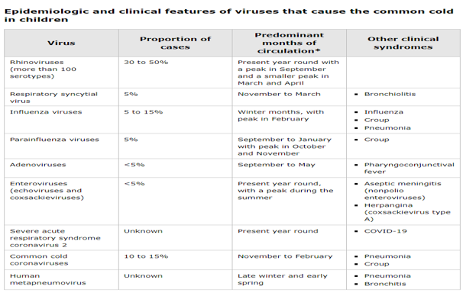
ETIOLOGY

Slide 8
Epidemiology
Colds occur year-round, but the incidence is greatest from the early fall until the late spring.
Young children have an average of 6-8 colds per year, but 10–15% of children have at least 12 infections per year.
The incidence of infection is primarily a function of exposure to the virus
The incidence of illness decreases with increasing age, with two to three illnesses per year by adulthood
Notes:
Seasonal patterns – The common cold may occur at any time of year, but there is typically a high prevalence during the fall and winter months as the different viruses move through the community in a predictable manner.

Slide 9
Pathogenesis
Transmission – Viruses that cause colds are spread by three mechanisms;
  Hand contact – Self-inoculation of one's own conjunctivae or nasal mucosa after touching a person or object contaminated with cold virus
  Inhalation of small particle droplets (droplet nuclei or aerosols) that become airborne from sneezing or coughing
  Deposition of large particle droplets that are expelled during sneezing and land on nasal or conjunctival mucosa (typically requires close contact with an infected person)
Notes:
The risk of person-to-person transfer is dependent upon the amount of time people spend together, the proximity of their contact with one another, and the amount of virus shed by the infected patient. Viral contamination of the hands of infected individuals is common. Rhinoviruses may remain viable on human skin for as long as two hours [13]. Rhinoviruses also can survive for up to one day on inanimate surfaces,

Slide 10
Cont…
Incubation period – The incubation period (time between contact with infectious material until the onset of symptoms) for most common cold viruses is 24 to 72 hours.
Period of infectivity – Rhinovirus shedding peaks on the third day after inoculation; this coincides with a peak in symptoms.
Low levels of viral shedding may persist for up to two weeks.
Notes:
Viral shedding of most respiratory viruses peaks 3-5 days after inoculation, often coinciding with symptom onset; low levels of viral shedding may persist for up to 3 weeks in the otherwise recovering healthy hos

Slide 11
Cont…
The respiratory viruses have evolved different mechanisms to avoid host defenses.
  Antigenic diversity,
  Mucosal immunoglobulin A (IgA) induced by previous infection is short lived,
  The brief incubation period of these viruses allows the establishment of infection before immune memory is able to respond.

Slide 12
CLINICAL MANIFESTATIONS
Sore throat (typically an early manifestation),
Fever
Nasal congestion
Runny nose
Cough (2/3)
Sneezing
Hoarseness, headache, irritability, difficulty sleeping, decreased appetite, anterior cervical adenopathy, and conjunctival injection.
Notes:
The first symptom noted is often sore or scratchy throat, followed closely by nasal obstruction and rhinorrhea.
The sore throat usually resolves quickly, and, by the second and third day of illness, nasal symptoms predominate.
Cough is associated with two thirds of colds in children and usually begins after the onset of nasal symptoms
Other symptoms of a cold may include headache, hoarseness, irritability, difficulty sleeping, or decreased appetite.
Vomiting and diarrhea are uncommon.
The usual cold persists for approximately 1 week, although 10% last for 2 weeks. Cough may persist for an additional 1-2 weeks after resolution o

Slide 13
DIAGNOSIS
The diagnosis of the common cold is made clinically, based upon history and examination findings.
Routine laboratory studies are not helpful for the diagnosis and management of the common cold.

Slide 14
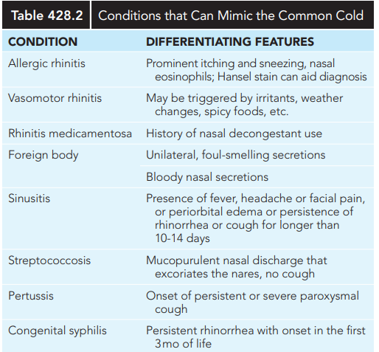
Differential diagnosis

Slide 15
Treatment
Supportive Care and Symptomatic Treatment

Slide 16
COMPLICATIONS
Acute otitis media (5-30%)
Sinusitis (5-9%)
Pneumonia
Exacerbation of Asthma

Slide 17
PREVENTION
Immunization or chemoprophylaxis against influenza
Frequent handwashing and avoiding touching one’s mouth, nose, and eyes

Slide 18
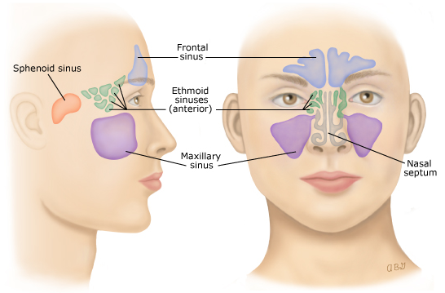
Sinusitis(Acute rhinosinusitis)
Ethmoidal and maxillary sinuses are present at birth, but only the ethmoidal sinuses are pneumatized.
The maxillary sinuses are not pneumatized until 4 years of age.
The sphenoidal sinuses begin at 2yr pneumatized by 5 years of age,
Frontal sinuses begin development at age 7-8 years and are not completely developed until adolescence

Slide 19
Definition
Sinusitis; is inflammation of the mucosal lining of one or more of the paranasal sinuses
The terms "sinusitis" and "rhinosinusitis" often are used interchangeably because inflammation of the paranasal sinuses is almost always accompanied by inflammation of the nasal mucosa.
Inflammation of the sinuses is common during uncomplicated upper respiratory infections but usually resolves spontaneously.

Slide 20
Etiology
Viral
Bacterial ( acute bacterial rhinosinusitis)
  Acute ( < 4week)
  Subacute(4wk—3month)
  Chronic (> 3month)
Fungal (rare)

Slide 21
Acute Bacterial Rhinosinusitis
The bacterial pathogens causing acute bacterial sinusitis in children and adolescents include
  Streptococcus pneumoniae (∼30%),
  Non-typeable Haemophilus influenzae (∼50%;),
  Moraxella catarrhalis (∼10%).
  Staphylococcus aureus, other streptococci, and anaerobes are uncommon causes of acute bacterial sinusitis in children.
Notes:
Approximately 50% of H. influenzae and 100% of M. catarrhalis are β-lactamase positive. Although S. aureus .is an uncommon pathogen for acute sinusitis in children, the increasing prevalence of methicillin-resistant S. aureus is a significant concern. H. influenzae, α- and β-hemolytic streptococci, M. catarrhalis, S. pneumoniae, and coagulase-negative staphylococci are commonly recovered from children with chronic sinus disease. Fusobacterium necrophorum and Streptococcus anginosus are emerging pathogens causing sinusitis with high poten

Slide 22
EPIDEMIOLOGY
Acute bacterial sinusitis can occur at any age and it’s a common problem.
Approximately 6 to 9 % of viral upper respiratory infections in children are complicated by the development of secondary ABRS.
In children, ABRS typically occurs at 4-7years of age, but it can occur at any age, even infancy.
ABRS is less common in children younger than two years of age than in older children
Notes:
Two factors contribute to the decreased prevalence of ABRS in younger children. First, in younger children, the viral antecedent infection predisposes to acute otitis media (AOM) and treatment of AOM with antibiotics prevents the viral infection from evolving to ABRS. Second, the sinus ostia are larger (relative to the body of the sinus) than in older children and therefore less likely to be obstructed.

Slide 23
Predisposing conditions
Viral upper respiratory tract infections
Allergic rhinitis,
Tobacco smoke exposure.
Children with immune deficiencies, particularly of antibody production (immunoglobulin [ig]G, igG subclasses, igA),
Cystic fibrosis ,
Ciliary dysfunction
Abnormalities of phagocyte function,
Gastroesophageal reflux,
Anatomic defects (cleft palate), nasal polyps,
Cocaine abuse
Nasal foreign bodies (including nasogastric tubes), can develop chronic or recurrent sinus disease.
Immunosuppression

Slide 24
PATHOGENESIS
The paranasal sinuses are usually sterile
Membranes that line the nose are continuous with the membranes that line the sinus cavities
The contaminating bacteria are typically removed by mucociliary clearance.
When mucociliary clearance is altered, the sinuses may be inoculated with large numbers of microorganisms, and infection may develop.
Mucociliary clearance is altered by conditions that damage the ciliary epithelium or affect the number or function of cilia, the production or viscosity of mucous, or the patency of the ostia (eg, upper respiratory infections, allergic rhinitis)

Slide 25
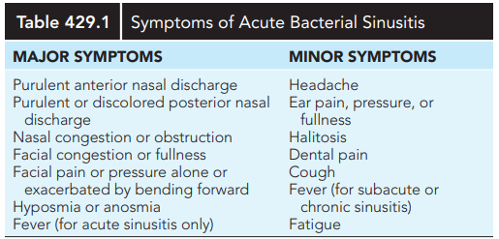
CLINICAL MANIFESTATIONS
Notes:
When viral URI is complicated by ABRS, there are three potential clinical presentations:
Persistent symptoms
Severe symptoms.
Worsening symptoms

Slide 26
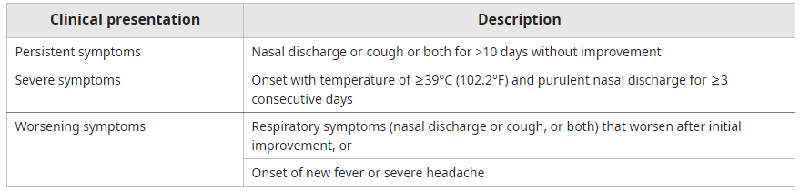
Clinical course
Has two clinical syndromes
  Uncomplicated Viral upper respiratory infection
  Acute bacterial rhinosinusitis

Slide 27
DIAGNOSIS
Uncomplicated ABRS in children is usually made clinically.
We use both of the following criteria for diagnosis
Symptoms and signs compatible with sinus inflammation (daytime cough, nasal symptoms, or both)
Clinical course suggestive of bacterial rather than viral infection, including
  Symptoms present without improvement for >10 and <30 days, or
  Severe symptoms (ill appearance, temperature ≥39°C (102.2°F), and purulent nasal discharge for ≥3 consecutive days), or
  Worsening symptoms (increase in respiratory symptoms, new onset of severe headache or fever, or recurrence of fever after initial improvement)
  NB; Imaging and microbiologic identification for complicated ABRS
Notes:
. In order to differentiate between the two, current pediatric guidelines define acute bacterial sinusitis as either (1) persistent symptoms of upper respiratory tract infection (rhinitis, common cold), including nasal discharge and/or daytime cough for longer than 10 days without improvement, (2) sudden worsening or new symptoms, known as twophase illness, or “double sickening,” including nasal discharge, daytime cough, or fever after initial improvement (Fig. 429.1), or (3) severe onset with temperature of at least 39°C (102°F) and purulent nasal discharge for 3-4 consecutive days. Bacteria are recovered from maxillary sinus aspirates in 70% of children with such persistent or severe symptoms. C

Slide 28
DDX
Viral upper respiratory tract infection
Allergic rhinitis
Nasal foreign body
Infected adenoids
GER

Slide 29
Complication of ABRS
Orbital
Cranial
Preseptal (periorbital) cellulitis
Orbital cellulitis
Orbital subperiosteal abscess
Orbital abscess
Septic cavernous sinus thrombosis
Meningitis
Osteomyelitis of the frontal bone associated with a subperiosteal abscess (Pott puffy tumor)
Epidural abscess
Subdural abscess
Brain abscess

Slide 30
TREATMENT
Supportive care
Symptomatic treatment
Antibiotics therapy

Slide 31
Prevention
Frequent handwashing and avoiding persons with colds.
Vaccination
Chemoprophylaxis

Slide 32
Acute Pharyngitis
Pharyngitis is the inflammation of the mucous membranes of the oropharynx.
Causes can be broadly categorized as infectious (usually viral(50-80%) or bacterial(GAS =5-36%)) and noninfectious.
The incidence peaks in childhood and adolescence with approximately 50 percent of all cases occurring before age 18

Slide 33
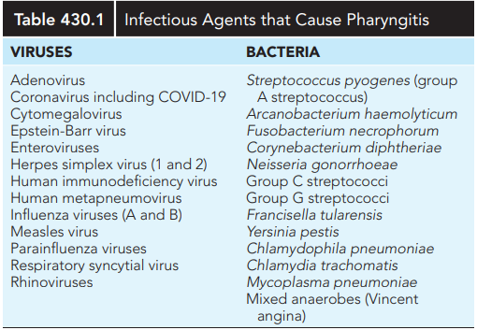
INFECTIOUS ETIOLOGIES

Slide 34
GAS pharyngitis
GAS is the most common cause of bacterial pharyngitis in children and adolescents.
It accounts for 15 to 30 percent of all cases of pharyngitis in children between the ages of 5 and 15 years
Streptococcal pharyngitis is relatively uncommon before 2-3 years of age,
Illness occurs throughout the year but is most prevalent in winter and spring.
It is readily spread among siblings and schoolmates.
Notes:
Children <3 years — Children <3 years of age generally do not have the findings that are typical of older children [11]. Instead of a well-defined episode of pharyngitis, they may have protracted symptoms of nasal congestion and discharge, low-grade fever (eg, <38.3°C [101°F]), and tender anterior cervical adenopathy [12]. This GAS symptom complex is called "streptococcosis."
Infants <1 year of age may present with nonspecific symptoms, including fussiness, decreased appetite, and low-grade fever. They often have older siblings or day care contacts with GAS infection.

Slide 35
Pathogenesis
Transmission occur though saliva and nasal secretion which facilitated via close contact.
Colonization of the pharynx by GAS can result in either asymptomatic carriage or acute infection.
After an incubation period of 2-5 days, pharyngeal infection with GAS classically presents as rapid onset of significant sore throat and fever

Slide 36
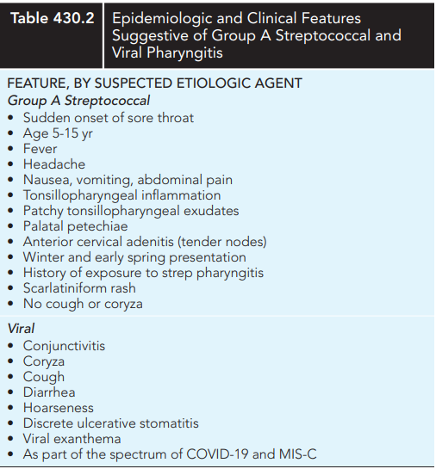

Slide 37
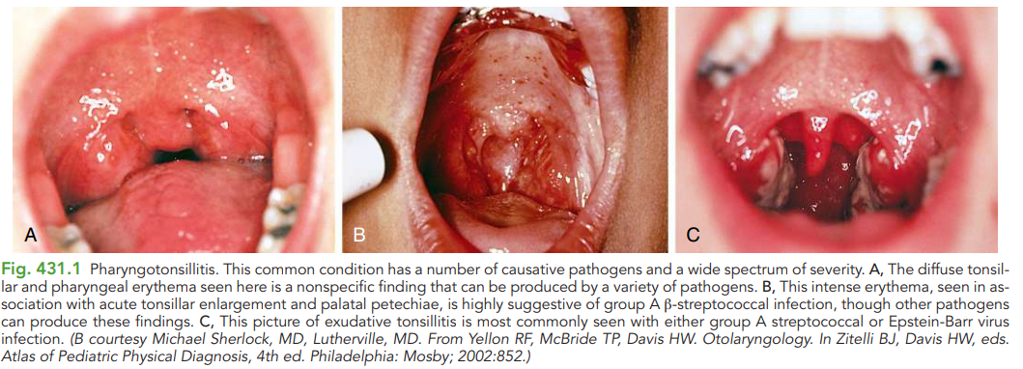
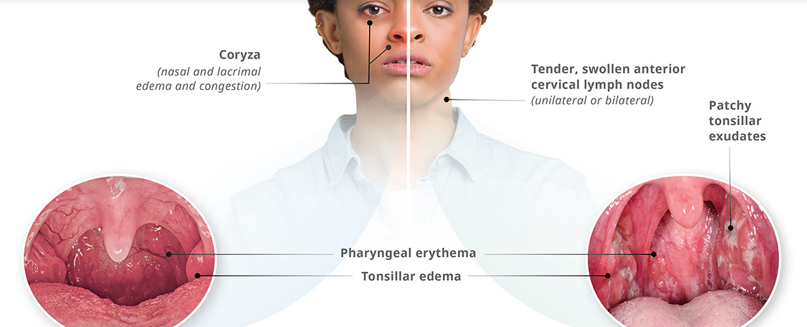

Slide 38
DIAGNOSIS
The clinical presentations of streptococcal and viral pharyngitis often overlap.
Based on clinical presentation and physical finding
The diagnosis of GAS pharyngitis is supported by a positive microbiologic test (throat culture, rapid antigen detection test [RADT], or molecular point-of-care test [POC] for GAS) in a patient with symptoms of GAS pharyngitis and absence of signs and symptoms of viral infections
Notes:
In particular, the pharyngitis of mononucleosis can be difficult to distinguish from GAS pharyngitis

Slide 39
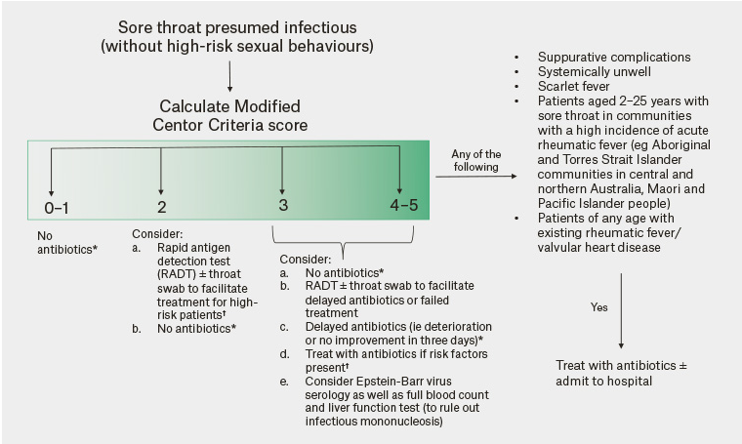
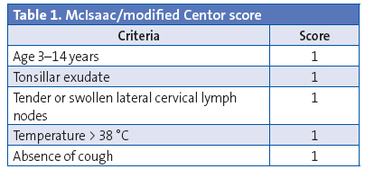
Notes:
At best, a McIsaac score ≥4 is associated with a positive laboratory test for GAS in less than 70% of children with pharyngitis (625

Slide 40
Treatment
GOALS OF TREATMENT
●Reducing symptom severity and duration
●Prevention of acute complications, such as otitis media, peritonsillar abscesses, or other invasive infections
●Prevention of delayed complications or immune sequelae, particularly acute rheumatic fever, APSGN, reactive arthritis
●Prevention of spread to others

Slide 41
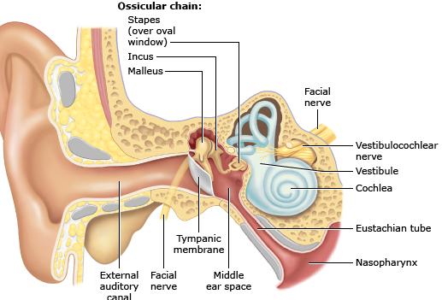
Acute ear infection(Otitis Media)
Acute otitis media is defined as an infection of the middle ear space.
It is a spectrum of diseases that includes
  Acute otitis media (AOM),
  Chronic suppurative otitis media (CSOM), and
  Otitis media with effusion (OME).
Acute otitis media is the second most common pediatric diagnosis in the emergency department, following upper respiratory infections.
Notes:
Recurrent OM is defined as a minimum of three episodes of AOM in 6 months or four episodes of AOM in 12 months with at least one of those episodes occurring in the preceding 6 months

Slide 42
Cont…
AOM occur at any age, but commonly seen between the ages of 6 to 24 months.
More than 80% of children experience at least one episode of OM by the age of 3 years
Accurate diagnosis of AOM in infants and young children may be difficult
Symptoms may not be apparent, especially in early infancy and in chronic stages of the disease

Slide 43
Risk and protective factors
RISK
PROTECTIVE FACTORS
Age
Family history
Daycare
Tobacco smoke and air pollution exposure
Pacifier use
Race & ethnicity
Socio economic status
Season of yr
Immunodeficiency
breast feedinBreast feeding
-Vaccination
–

Slide 44
Etiology
Three pathogens predominate in AOM:
  Streptococcus pneumoniae
  Non-typeable Haemophilus influenzae
  Moraxella catarrhalis
Of these viruses, rhinovirus and respiratory syncytial virus are found most often
Notes:
The pathogenesis of AOM in at-risk children generally involves the following sequence of events [51-54]:
●The patient has an antecedent event (usually a viral upper respiratory tract infection) while colonized with an otopathogen(s) [45]. Some evidence suggests that co-colonization with bacterial otopathogens may be sufficient to trigger the cascade of events in the absence of viral respiratory infection [53,55,56].
●The event results in inflammatory edema of the respiratory mucosa of the nose, nasopharynx, and Eustachian tube.
●Inflammatory edema obstructs the narrowest portion of the Eustachian tube (the isthmus).
●Obstruction of the isthmus causes poor ventilation and negative middle ear pressure. This leads to the accumulation of secretions produced by the middle ear mucosa.
●Viruses and bacteria that colonize the upper respiratory tract enter the middle ear via aspiration, reflux, or insufflation.
●Microbial growth in the middle ear secretions often progresses to suppuration with clinical signs of AOM (bulging tympanic membrane [TM], middle ear fluid, erythematous TM).
●The middle ear effusion may persist for weeks to months following sterilization of the middle ear infection.

Slide 45
Pathogenesis
The patient has an antecedent event (usually a viral upper respiratory tract infection) while colonized with an otopathogen(s).
The event results in inflammatory edema of the respiratory mucosa of the nose, nasopharynx, and Eustachian tube.
Inflammatory edema obstructs the narrowest portion of the Eustachian tube (the isthmus).
Obstruction of the isthmus causes poor ventilation and negative middle ear pressure( leads to the accumulation of secretions produced by the middle ear mucosa).
Viruses and bacteria that colonize the upper respiratory tract enter the middle ear via aspiration, reflux, or insufflation.
Notes:
The patient has an antecedent event (usually a viral upper respiratory tract infection) while colonized with an otopathogen(s) [45]. Some evidence suggests that co-colonization with bacterial otopathogens may be sufficient to trigger the cascade of events in the absence of viral respiratory infection

Slide 46
Clinical manifestation
Ear pain, ear rubbing, hearing loss, ear drainage & fever.
Young children with AOM, particularly infants, may present with nonspecific symptoms and signs (eg, fever, fussiness, disturbed or restless sleep, poor feeding/anorexia, vomiting, diarrhea)

Slide 47
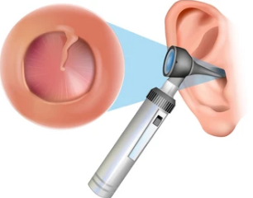
Diagnosis
A diagnosis of AOM should be made in children who present with:
  Moderate to severe bulging of the TM or new-onset otorrhea not caused by otitis externa
  Mild bulging of the TM and recent (<48hr) onset of ear pain or intense TM erythema
Notes:
A clinical diagnosis of AOM can be made in children with either
●Bulging of the tympanic membrane distinct fullness or bulging of the tympanic membrane is the most specific and reproducible sign of acute inflammation.
●Perforation of the tympanic membrane with acute purulent otorrhea if acute otitis externa has been excluded.

Slide 48
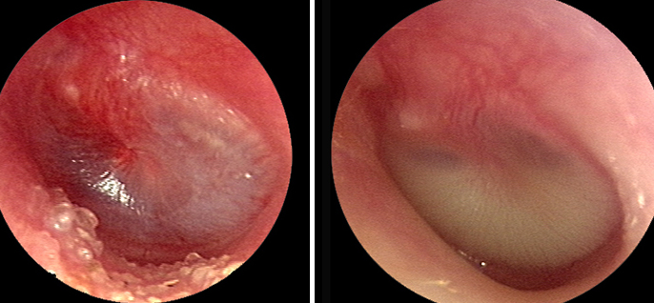
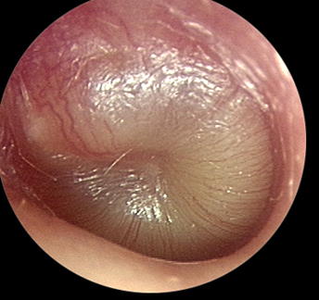
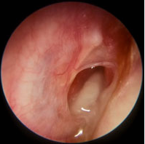

Slide 49
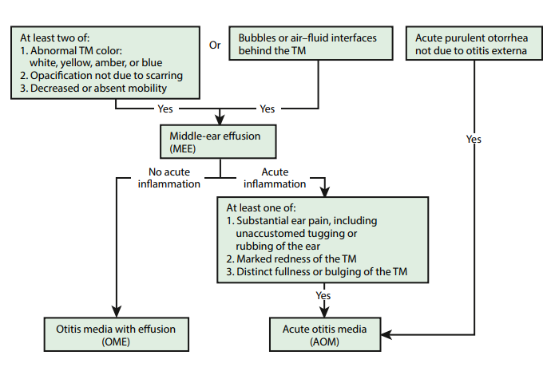

Slide 50
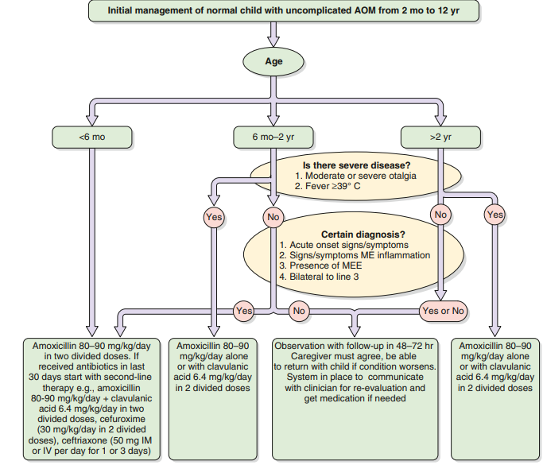
Treatment approach

Slide 51
Complications and sequelae
Intratemporal complications
Intracranial complications
Hearing loss
Balance and motor problems
Tympanic membrane abnormalities
Chronic suppurative otitis media
Mastoiditis
Petrositis
Labyrinthitis
Facial paralysis
Meningitis
Epidural abscess
Brain abscess
Lateral sinus thrombosis
Cavernous sinus thrombosis
Subdural empyema)
Carotid artery thrombosis

Slide 52
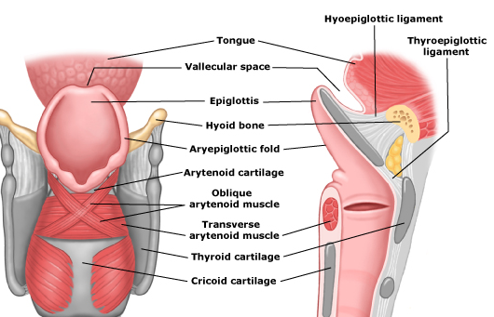
Acute Epiglottitis
Epiglottitis refers to inflammation of the epiglottis and adjacent supraglottic structures, primarily due to infection.
Without treatment, epiglottitis can progress to life-threatening airway obstruction.

Slide 53
Etiology
Infectious
Non infectious
Bacterial pathogens
  Haemophilus influenzae type b (Hib)
  Staphylococcus aureus
  Streptococcus pneumoniae ,Streptococcus pyogenes and other streptococci
  Neisseria meningitidis
  Pasteurella multocida
  Viral
  Influenza, type a ,Influenza, type b ,Herpes simplex virus, types 1 and 2 ,Parainfluenza virus, type 3,Epstein-Barr virus ,Human immunodeficiency virus (HIV) ,SARS-CoV-2.
  Fungal(candida albican)
Local airway trauma such as:
  Thermal injury from:
    -Ingestion of hot beverages or food
    -E-cigarette use or inhalation of heated objects during use of illicit drugs such as crack cocaine
  Direct trauma to the epiglottis
  Caustic ingestion or inhalation
Lymphoproliferative disease or GVH-disease after bone marrow or solid organ transplantation
Chronic granulomatous disorders
Notes:
Chronic granulomatous disorders including polyangiitis, sarcoidosis, systemic lupus erythematosus, relapsing polychondritis, and immunoglobulin G4 (IgG4)-related diseas

Slide 54
Clinical presentation
Acute (fever and stridor)
Subacute (severe sore throat)
Toxic appearance and distress (agitation, restlessness, irritability Sudden onset of high fever (between 38.8 and 40.0°C)
Stridor
Drooling
Change in voice (muffled, "hot potato" voice)
Severe sore throat and dysphagia
"tripod" posture
Progressively painful sore throat
Low-grade fever
Muffled ("hot potato") or hoarse voice
Difficulty with swallowing
Drooling
Notes:
The clinical features of epiglottitis differ with age, severity, and etiology

Slide 55
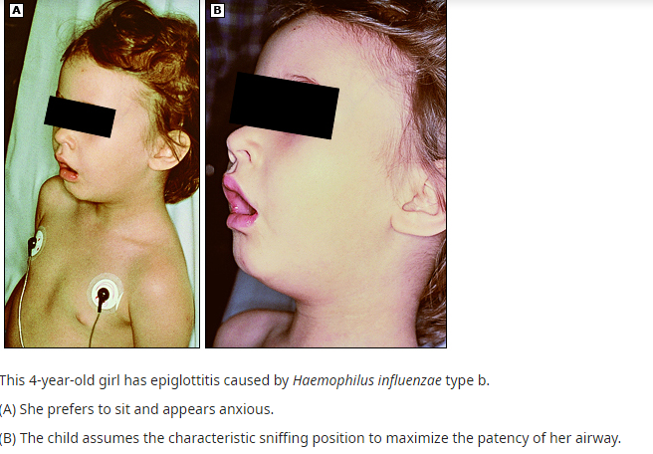
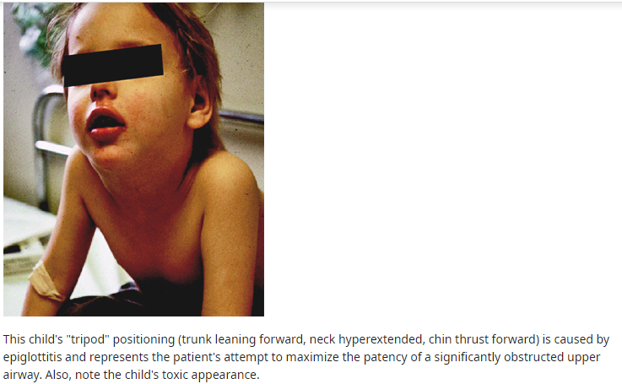

Slide 56
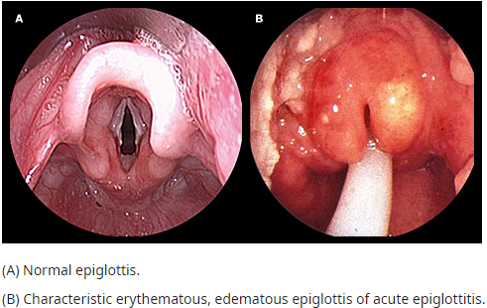
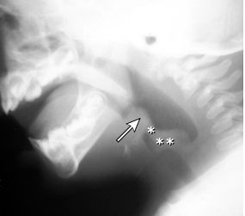
DIAGNOSIS
Clinical suspicion — Epiglottitis typically presents in one of two ways:
●Progressive, severe sore throat over several days
●Abrupt onset of fever, stridor, and respiratory distress over 24 hours
  •"Tripod" position ,Anxiety ,Sore throat ,Stridor,Drooling,Dysphagia ,Severe respiratory distress
Diagnostic confirmation
Visualization of the epiglottis
Plain radiographs
Laboratory
Microbiology
Notes:
Clinical suspicion — Epiglottitis typically presents in one of two ways:
●Progressive, severe sore throat over several days – Epiglottitis should be suspected in older children, adolescents, and adults in whom the severity of sore throat is out of proportion to the findings on oropharyngeal examination, particularly if significant dysphagia and drooling are present [5]. These patients are appropriate candidates for confirmation by direct visualization of the upper airway or soft-tissue radiograph of the lateral neck.
●Abrupt onset of fever, stridor, and respiratory distress over 24 hours – Acute epiglottitis with severe airway obstruction should be suspected in patients, especially those who are un- or under-immunized against H. influenzae type b (Hib), who present with the characteristic clinical features including:
•"Tripod" position (picture 1)
•Anxiety (picture 2)
•Sore throat
•Stridor
•Drooling
•Dysphagia
•Severe respiratory distress
Radiographic features of epiglottitis include :
●An enlarged epiglottis protruding from the anterior wall of the hypopharynx (the "thumb sign",.
●Loss of the vallecular air space, a finding that may be underappreciated.
●Thickened aryepiglottic folds .
●Distended hypopharynx (nonspecific).
●Straightening or reversal of the normal cervical lordosis (nonspecific).

Slide 57
DDX
Croup
Bacterial tracheitis
Peritonsillar or retropharyngeal infection
Foreign bodies
Angioedema (anaphylaxis or hereditary)
Congenital anomalies and laryngeal papillomas
Diphtheria
Other causes of epiglottic enlargement
Uvulitis

Slide 58
Management
Immediate airway management
Supplemental oxygen
Antibiotics
Supportive measure
Minimize disturbance

Slide 59
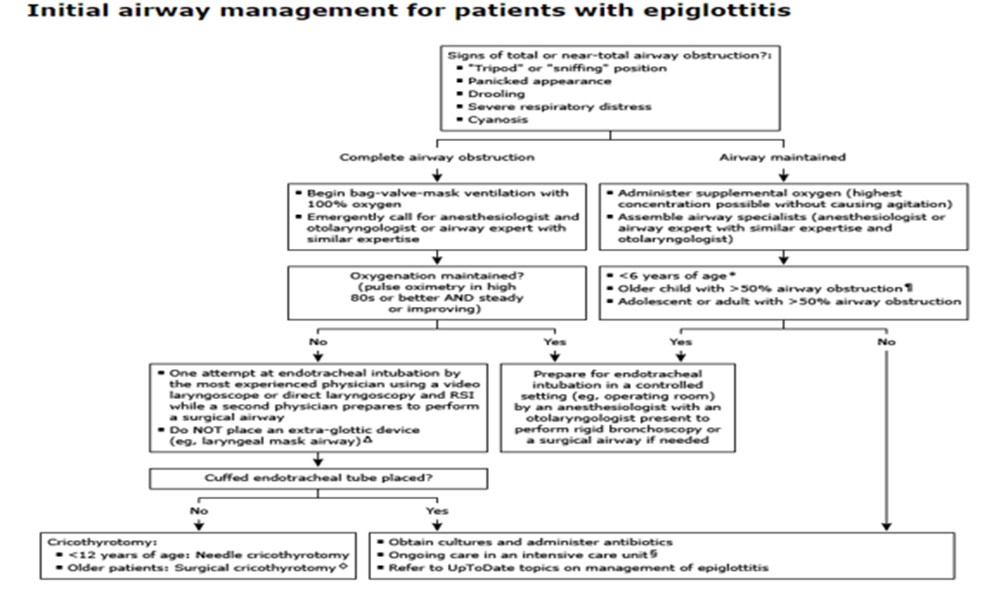

Slide 60
Complication
Airway obstruction
Epiglottic abscess
Secondary infection
Necrotizing epiglottitis
Death

Slide 61
PREVENTION
Immunization
Postexposure prophylaxis

Slide 62
Croup (Laryngotracheobronchitis)
Croup is a respiratory illness characterized by inspiratory stridor, barking cough, and hoarseness.
These symptoms result from inflammation in the larynx and subglottic airway.
Croup is one of the most common respiratory illnesses in young children.
It occurs mostly in children ≤6 years old, with a peak incidence between six months to three years of age; it is uncommon in children >6 years old

Slide 63
Etiology
Viral
bacterial
Parainfluenza viruses(T1,2,3)
Rhinovirus, respiratory syncytial virus (RSV), and adenoviruses
SARS-CoV-2
Influenza
Other human coronaviruses
Measles
Mycoplasma pneumoniae,
Corynebacterium diphtheriae.
Secondary bacterial infection

Slide 64
Pathogenesis
The viruses that cause croup typically infect the nasal and pharyngeal mucosal epithelia initially and then spread locally along the respiratory epithelium to the larynx and trachea.
Anatomic hallmark of croup is narrowing of the subglottic airway, the portion of the larynx immediately below the vocal folds.
The cricoid cartilage of the subglottis is a complete cartilaginous ring, unlike the tracheal rings, which are horseshoe shaped.
Notes:
Because it is a complete ring, the cricoid cannot expand, causing significant airway narrowing whenever the subglottic mucosa becomes inflamed. In addition to this "fixed" obstruction, dynamic obstruction of the extrathoracic trachea below the cartilaginous ring may occur when the child struggles, cries, or becomes agitated. The dynamic obstruction occurs as a result of the combination of high negative pressure in the distal extrathoracic trachea and the floppiness of the tracheal wall in children.

Slide 65
Clinical presentation
Symptoms usually begin with nasal discharge and congestion and progress over 12 to 48 hours to include fever, hoarseness, barking cough, and stridor.
As airway narrowing progresses, stridor develops and there may be mild tachypnea with a prolonged inspiratory phase.
When airway obstruction becomes severe, suprasternal, subcostal, and intercostal retractions may be seen , Breath sounds can be diminished.

Slide 66
Cont…
Underlying host factors that predispose to clinically significant narrowing of the upper airway include:
  Congenital and acquired airway abnormalities,
    laryngomalacia, laryngeal clefts, subglottic stenosis, vallecular cysts, or subglottic hemangiomas
    Hyperactive airways,
    Previous intubation

Slide 67
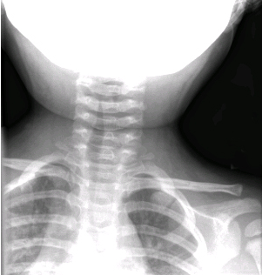
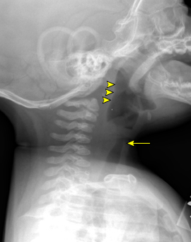
Diagnosis
Croup is diagnosed clinically, based upon the characteristic barking cough and stridor
Supportive diagnosis via radiography and laboratory
Notes:
https://youtu.be/sZrrtC7Pj6I?si=VO70R0JS-B-y35K_

Slide 68
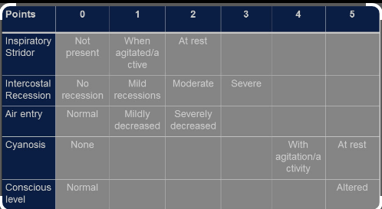
Severity assessment
Mild croup (Westley croup score ≤2)
Moderate croup (Westley croup score 3 to 7)
Severe croup (Westley croup score ≥8)
Impending respiratory failure (Westley croup score ≥12)

Slide 69
Differential diagnosis
Acute epiglottitis
Bacterial tracheitis
Peritonsillar, parapharyngeal, or retropharyngeal abscesses
Foreign body
Allergic reaction or acute angioneurotic edema
Upper airway injury
Anomalies of the airway

Slide 70
Management
Depend on severity of croup
Mild croup → out patient with oral glucocorticoid
Moderate to severe croup
Managed at EOPD
  Airway management
  Supplemental oxygen
  Iv/im glucocorticoid
  Nebulized epinephrin
  Hydration
  Supportive care

Slide 71
OUTCOME
Croup is usually a self-limited illness that resolves within 24 to 72 hours, though the cough may persist for up to one week
Approximately 5 to 10 percent of children with croup presenting to the emergency department require hospitalization.
Mortality is exceedingly rare (<0.1 percent of those who require hospitalization
Notes:
Indications for inpatient admission include :
●Severe croup with poor air entry, altered consciousness, or impending respiratory failure
●Moderate/severe croup symptoms that recur or persist after initial treatment (consisting of glucocorticoids and one to two nebulized epinephrine treatments)
●"Toxic" appearance or clinical picture suggesting potential serious secondary bacterial infection
●Need for supplemental oxygen
●Severe dehydration
Additional factors that influence the decision regarding admission include:
●Young age, particularly <6 months
●Recurrent visits to the ED within 24 hours
●Ability of the parents/caregivers to comprehend the instructions regarding recognition of features that indicate the need to return for care

Slide 72
Reference
Nelson text book of pediatrics 22nd edition
Rudolph’s pediatrics 23rd edition
Red book 2024
AAP 2018
UpToDate 2024

Slide 73
THANK YOU!!!

